Slide 1
ADC
VAD
SID
STAR
Caucasus
Nevada NTTR
Persian Gulf
IAC
AMDT 03 – 28/04/2020
Georgia
Nevada USA
Persian Gulf

Slide 2
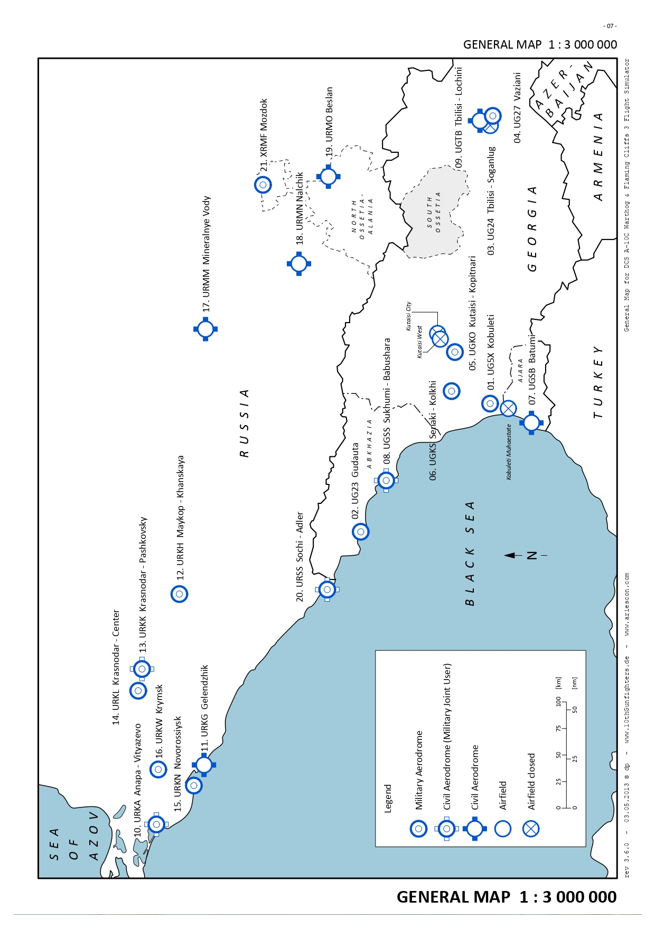
ADC
VAD
SID
STAR
IAC
Batumi
UG5X
Gudauta
UG5X
Kobuleti
UG5X
Kutaisi
Kopitnari
UG5X
Senaki
Kolkhi UG5X
Sukhumi
Babushara UG5X
Tbilisi
Lochini
UG5X
Tbilisi
Soganlug
UG5X
Vaziani
UG5X

Slide 3
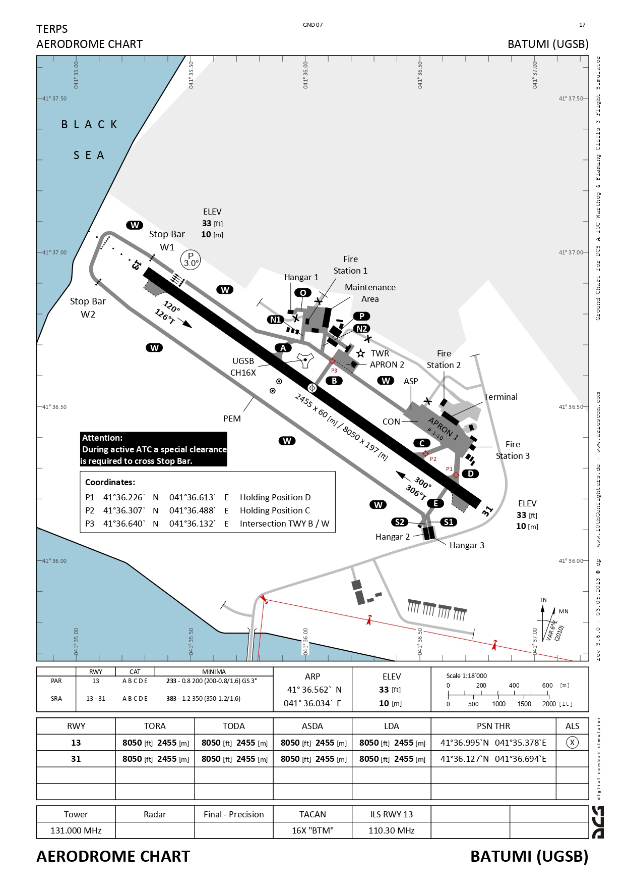
BATUMI - UGSB
Aerodrome Chart – 1/1
ADC
Georgia
VOC
SID
IAC
126.5 222.2 MHz
GCA
ATIS
120.1 225.4
122.55 MHz
Batumi
UG5X
Gudauta
UG5X
Kobuleti
UG5X
Kutaisi
Kopitnari
UG5X
Senaki
Kolkhi UG5X
Sukhumi
Babushara UG5X
Tbilisi
Lochini
UG5X
Tbilisi
Soganlug
UG5X
Vaziani
UG5X

Slide 4
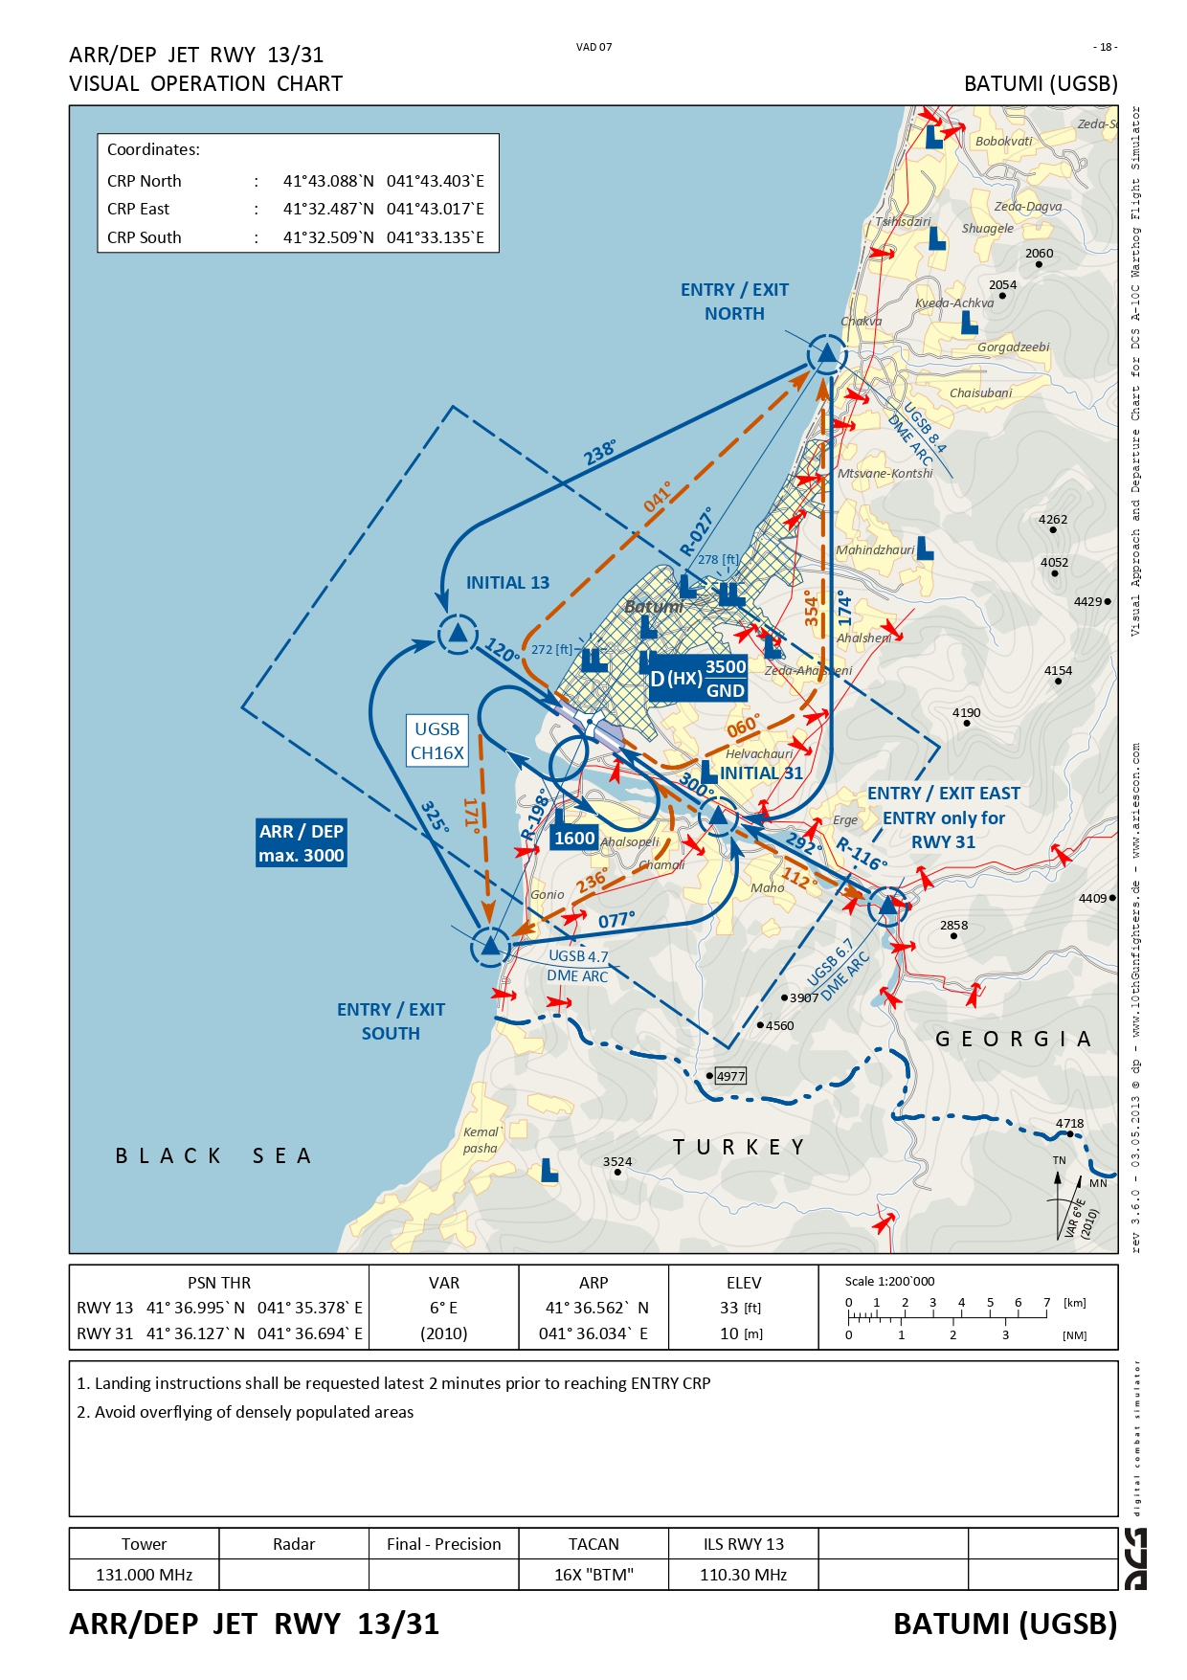
BATUMI - UGSB
Visual Operation Chart – 1/1
ADC
Georgia
VOC
SID
IAC
126.5 222.2 MHz
GCA
ATIS
120.1 225.4 MHz
122.55 MHz
Batumi
UG5X
Gudauta
UG5X
Kobuleti
UG5X
Kutaisi
Kopitnari
UG5X
Senaki
Kolkhi UG5X
Sukhumi
Babushara UG5X
Tbilisi
Lochini
UG5X
Tbilisi
Soganlug
UG5X
Vaziani
UG5X

Slide 5
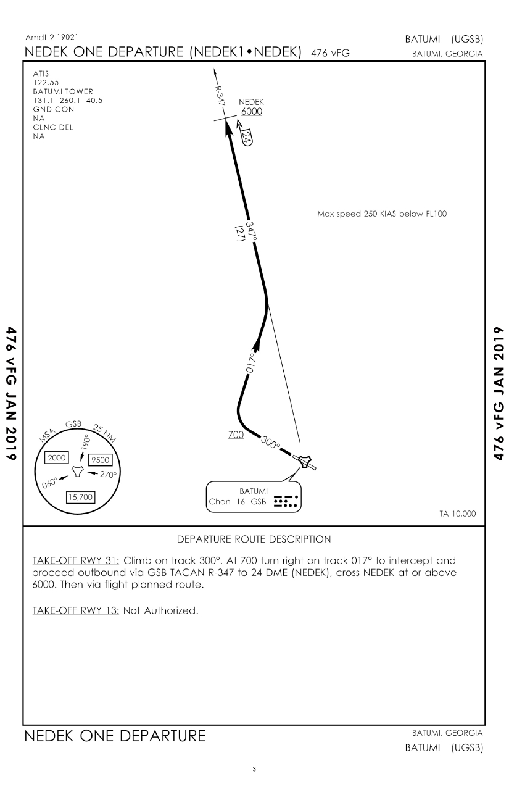
BATUMI - UGSB
SID NEDEK1 DEP – 1/2
ADC
Georgia
VOC
SID
IAC
Batumi
UG5X
Gudauta
UG5X
Kobuleti
UG5X
Kutaisi
Kopitnari
UG5X
Senaki
Kolkhi UG5X
Sukhumi
Babushara UG5X
Tbilisi
Lochini
UG5X
Tbilisi
Soganlug
UG5X
Vaziani
UG5X

Slide 6
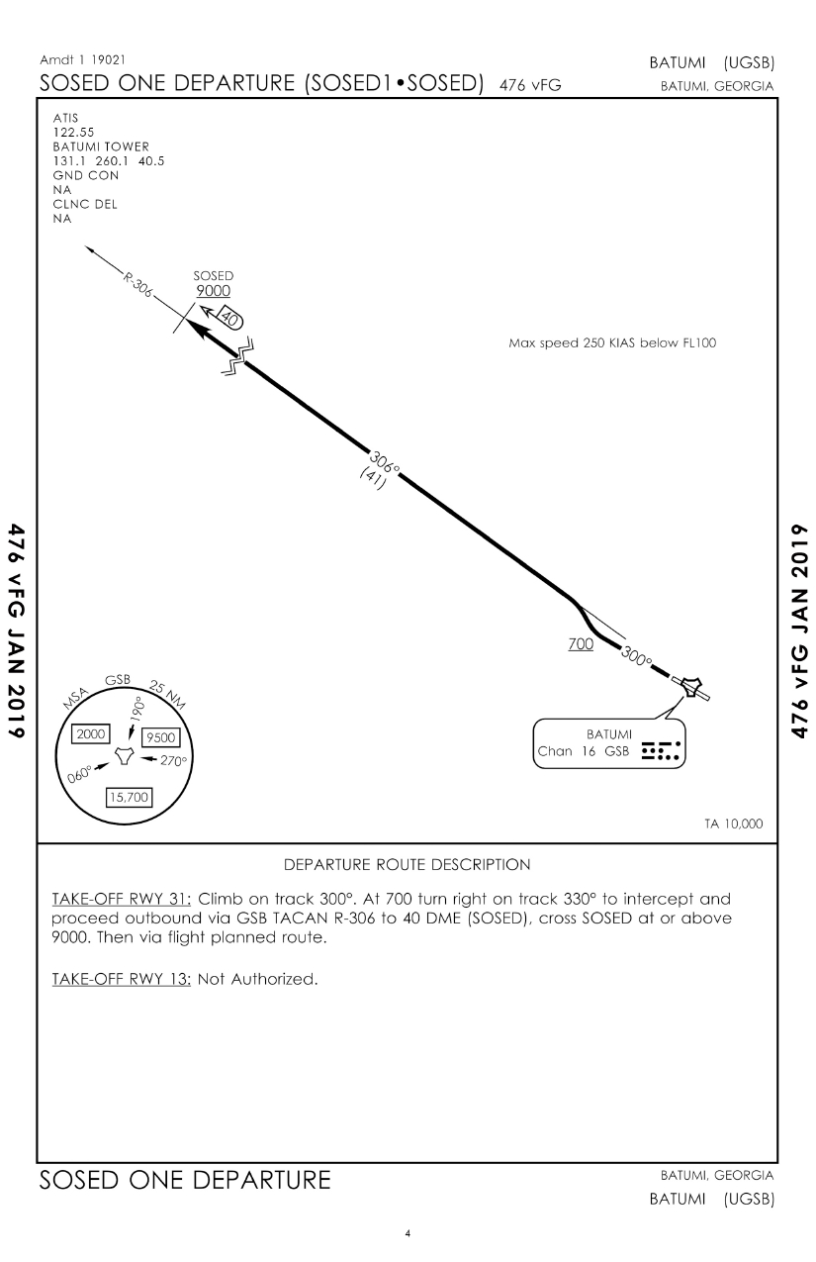
BATUMI - UGSB
SID SOSED1 DEP – 2/2
ADC
Georgia
VOC
SID
IAC
Batumi
UG5X
Gudauta
UG5X
Kobuleti
UG5X
Kutaisi
Kopitnari
UG5X
Senaki
Kolkhi UG5X
Sukhumi
Babushara UG5X
Tbilisi
Lochini
UG5X
Tbilisi
Soganlug
UG5X
Vaziani
UG5X

Slide 7
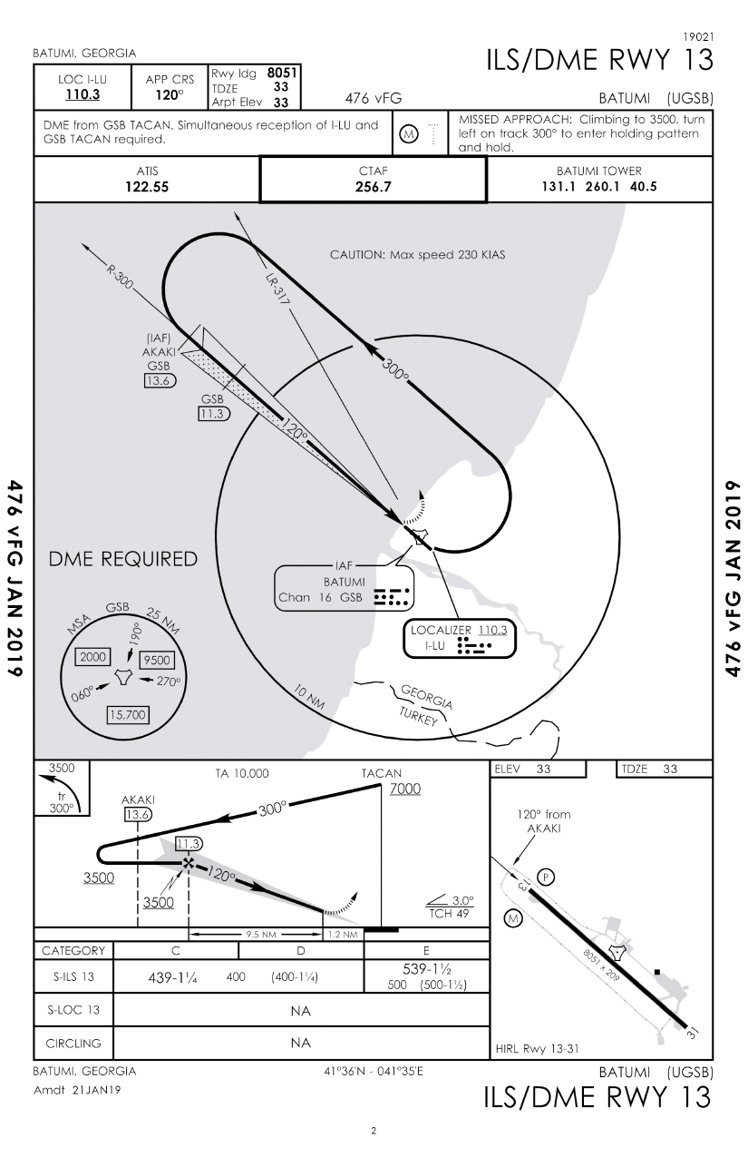
BATUMI - UGSB
ILS / DEM RWY 13 – 1/1
ADC
Georgia
VOC
ATIS 122.55 | CTAF 256.7 | APP 126.5 220.2 | GCA 120.1 225.4 | BATUMI TOWER 131.1 260.1
SID
IAC
Batumi
UG5X
Gudauta
UG5X
Kobuleti
UG5X
Kutaisi
Kopitnari
UG5X
Senaki
Kolkhi UG5X
Sukhumi
Babushara UG5X
Tbilisi
Lochini
UG5X
Tbilisi
Soganlug
UG5X
Vaziani
UG5X

Slide 8
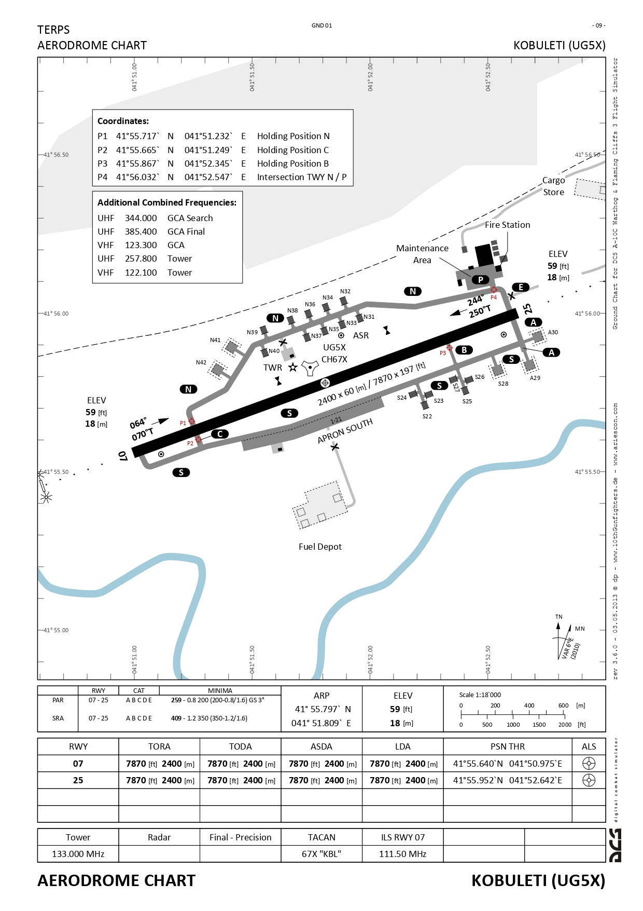
KOBULETI – UG5X
Aerodrome Chart – 1/1
ADC
Georgia
VOC
ATIS
132.55 MHz
Batumi
UG5X
Gudauta
UG5X
Kobuleti
UG5X
Kutaisi
Kopitnari
UG5X
Senaki
Kolkhi UG5X
Sukhumi
Babushara UG5X
Tbilisi
Lochini
UG5X
Tbilisi
Soganlug
UG5X
Vaziani
UG5X

Slide 9
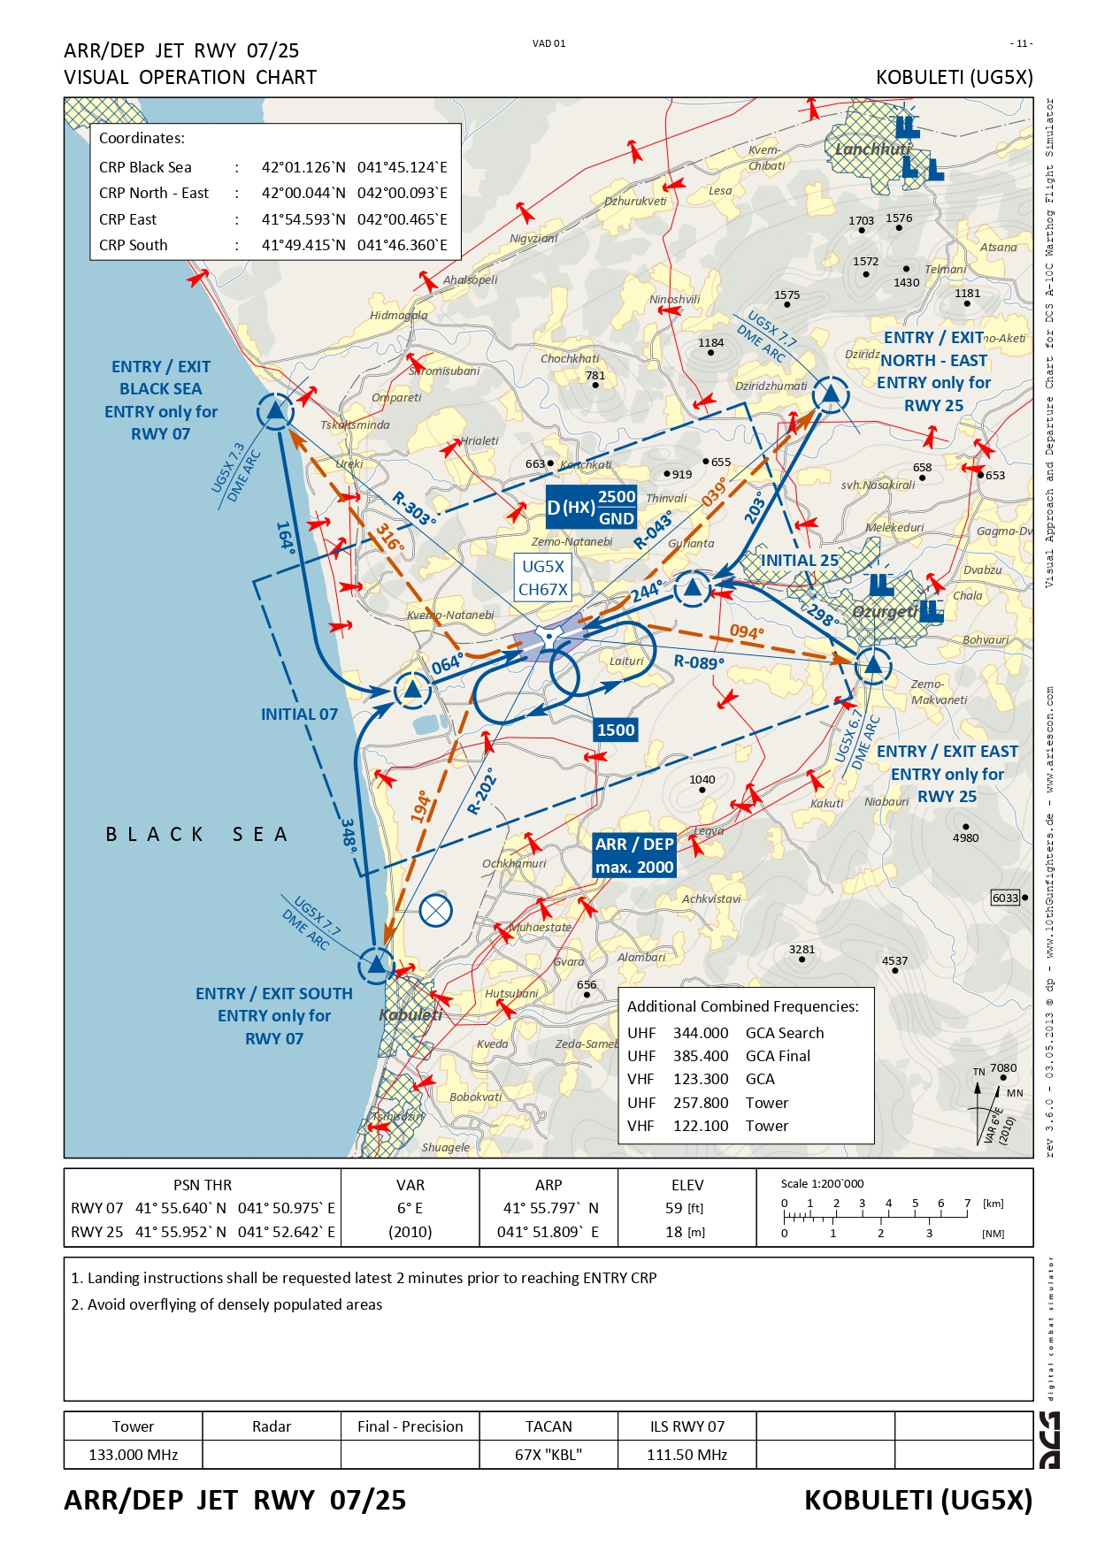
KOBULETI – UG5X
Visual Operation Chart – 1/1
ADC
Georgia
VOC
ATIS
132.55 MHz
Batumi
UG5X
Gudauta
UG5X
Kobuleti
UG5X
Kutaisi
Kopitnari
UG5X
Senaki
Kolkhi UG5X
Sukhumi
Babushara UG5X
Tbilisi
Lochini
UG5X
Tbilisi
Soganlug
UG5X
Vaziani
UG5X

Slide 10
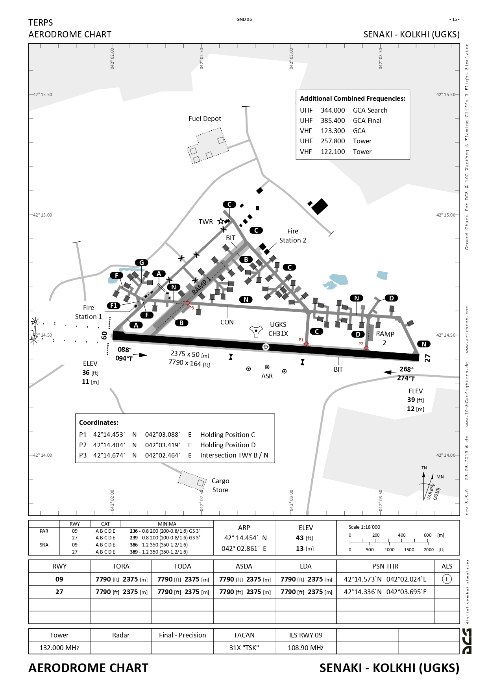
SENAKI KOLKHI - UGKS
Aerodrome Chart – 1/2
ADC
Georgia
VOC
IAC
119.5 228.55 MHz
122.1 222.6 MHz
ATIS
122.585 MHz
Batumi
UG5X
Gudauta
UG5X
Kobuleti
UG5X
Kutaisi
Kopitnari
UG5X
Senaki
Kolkhi UG5X
Sukhumi
Babushara UG5X
Tbilisi
Lochini
UG5X
Tbilisi
Soganlug
UG5X
Vaziani
UG5X

Slide 11
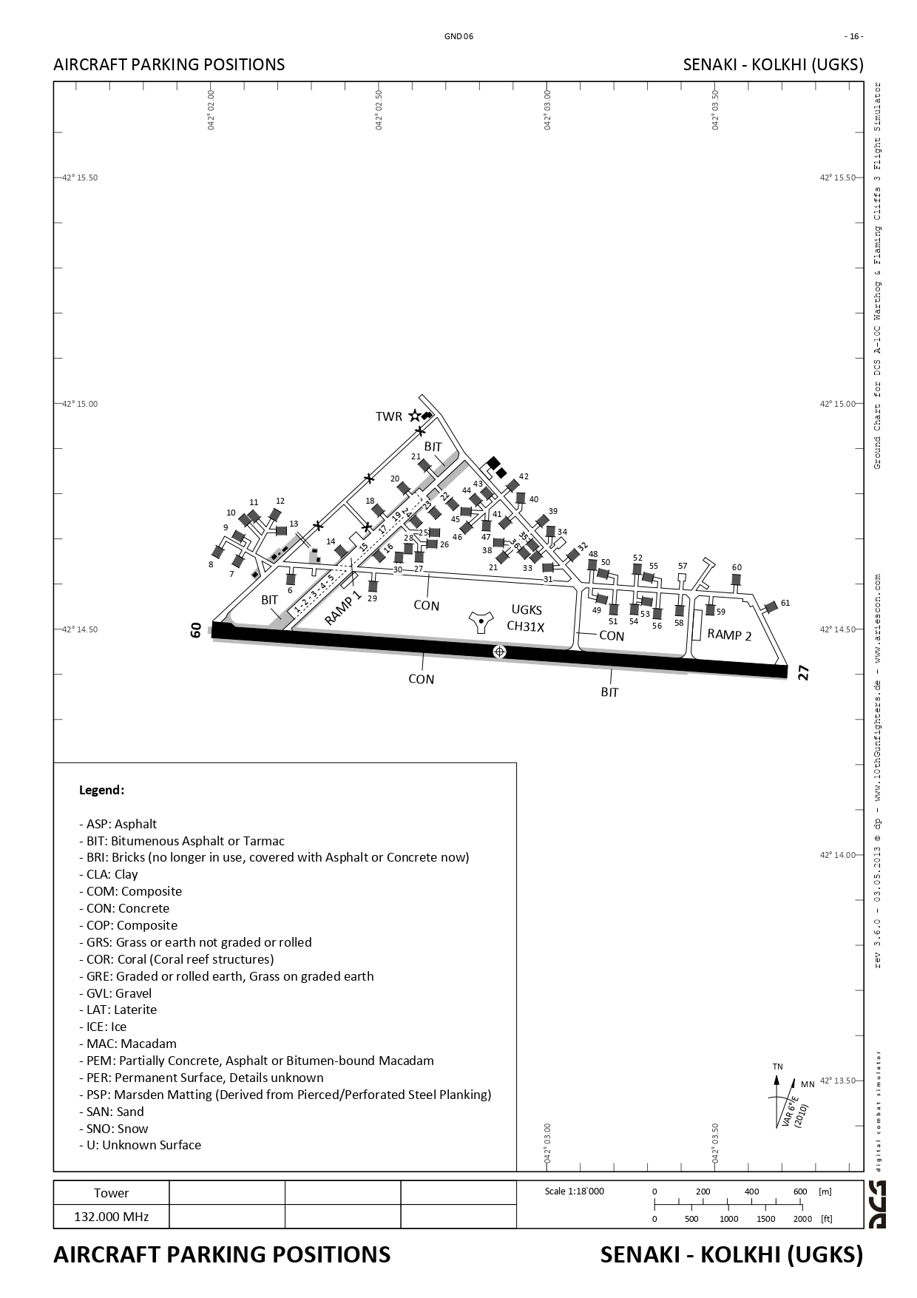
SENAKI KOLKHI - UGKS
Aircraft Parking Position 1/2
ADC
Georgia
VOC
IAC
Radar
Final Precision
ATIS
119-5 228.55 MHz
122.1 222.6 MHz
122.585 MHz
Batumi
UG5X
Gudauta
UG5X
Kobuleti
UG5X
Kutaisi
Kopitnari
UG5X
Senaki
Kolkhi UG5X
Sukhumi
Babushara UG5X
Tbilisi
Lochini
UG5X
Tbilisi
Soganlug
UG5X
Vaziani
UG5X

Slide 12
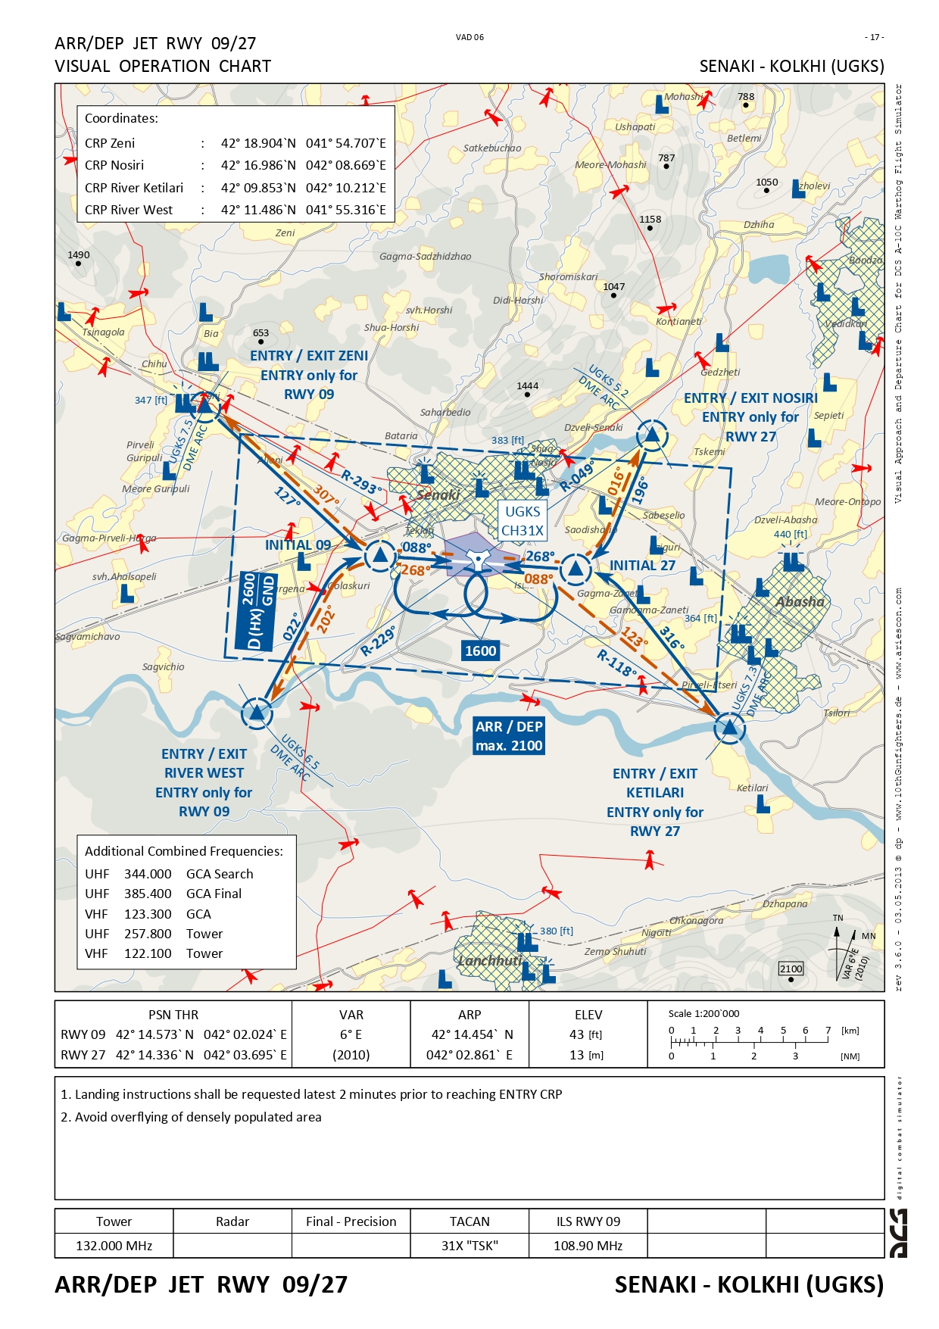
SENAKI KOLKHI - UGKS
Visual Operation Chart – 1/1
ADC
Georgia
VOC
IAC
119.5 228.55 MHz
122.1 222.6
ATIS
122.525 MHz
Batumi
UG5X
Gudauta
UG5X
Kobuleti
UG5X
Kutaisi
Kopitnari
UG5X
Senaki
Kolkhi UG5X
Sukhumi
Babushara UG5X
Tbilisi
Lochini
UG5X
Tbilisi
Soganlug
UG5X
Vaziani
UG5X

Slide 13
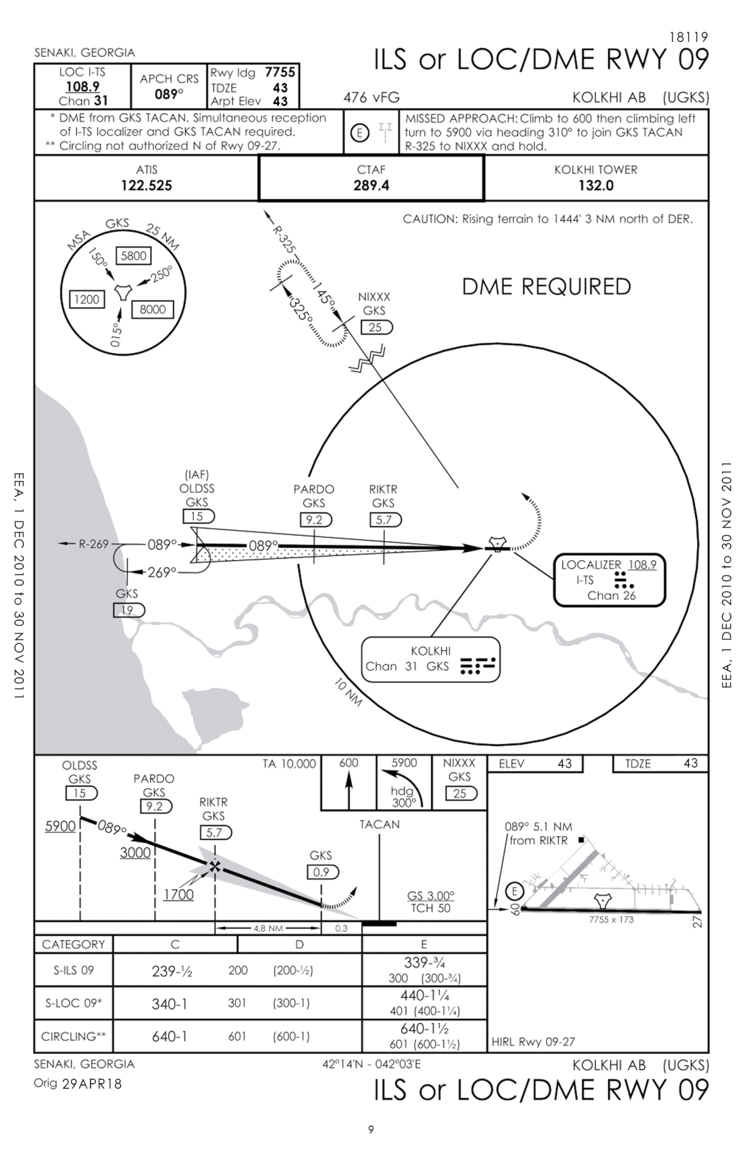
SENAKI KOLKHI - UGKS
Visual Operation Chart – 1/1
ADC
Georgia
VOC
ATIS 122.525 | CTAF 289.4 | APP 119.5 228.55 | GCA 122.1 222.6 | SENAKI TOWER 132.0 240.1
IAC
122.585 MHz
122.585 MHz
Batumi
UG5X
Gudauta
UG5X
Kobuleti
UG5X
Kutaisi
Kopitnari
UG5X
Senaki
Kolkhi UG5X
Sukhumi
Babushara UG5X
Tbilisi
Lochini
UG5X
Tbilisi
Soganlug
UG5X
Vaziani
UG5X

Slide 14
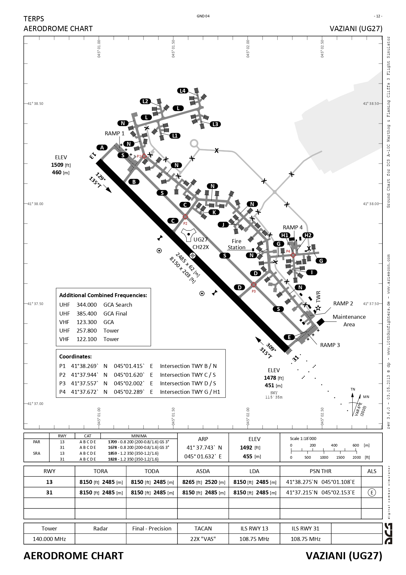
VAZIANI – UG27
Aerodrome Chart – 1/2
ADC
Georgia
VOC
SID
IAC
ATIS
122.7 MHz
Batumi
UG5X
Gudauta
UG5X
Kobuleti
UG5X
Kutaisi
Kopitnari
UG5X
Senaki
Kolkhi UG5X
Sukhumi
Babushara UG5X
Tbilisi
Lochini
UG5X
Tbilisi
Soganlug
UG5X
Vaziani
UG5X

Slide 15
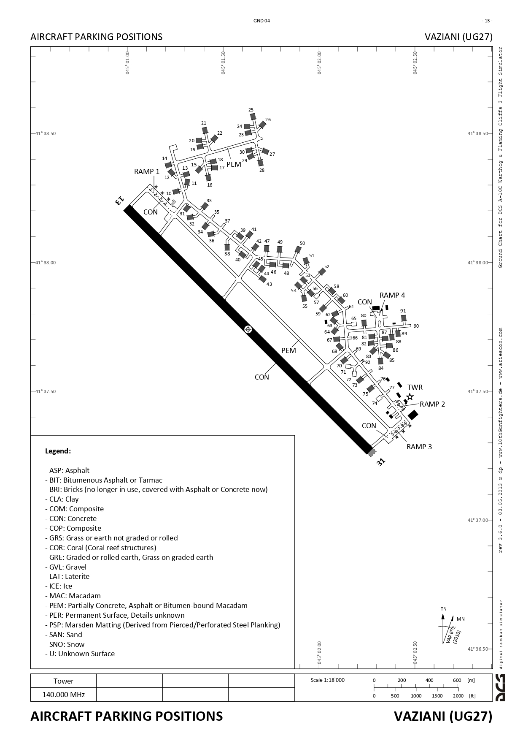
VAZIANI – UG27
Aircraft Parking Position – 2/2
ADC
Georgia
VOC
SID
IAC
ATIS
122.7 MHz
Batumi
UG5X
Gudauta
UG5X
Kobuleti
UG5X
Kutaisi
Kopitnari
UG5X
Senaki
Kolkhi UG5X
Sukhumi
Babushara UG5X
Tbilisi
Lochini
UG5X
Tbilisi
Soganlug
UG5X
Vaziani
UG5X

Slide 16
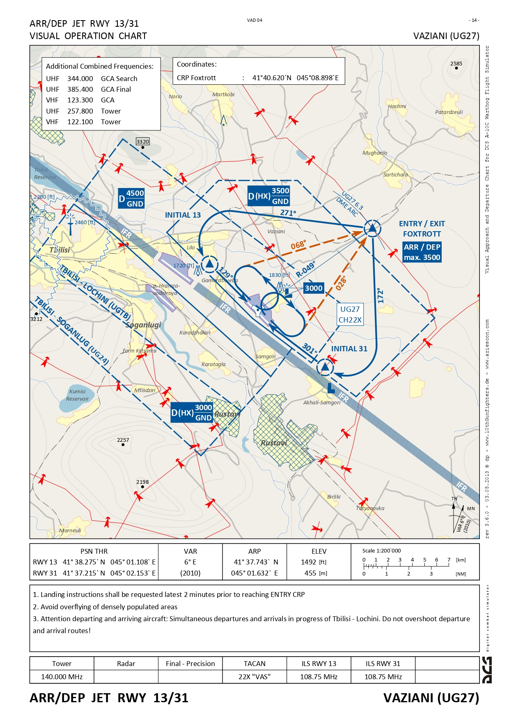
VAZIANI – UG27
Visual Operation Chart – 1/1
ADC
Georgia
VOC
SID
IAC
ATIS
122.7 MHz
Batumi
UG5X
Gudauta
UG5X
Kobuleti
UG5X
Kutaisi
Kopitnari
UG5X
Senaki
Kolkhi UG5X
Sukhumi
Babushara UG5X
Tbilisi
Lochini
UG5X
Tbilisi
Soganlug
UG5X
Vaziani
UG5X

Slide 17
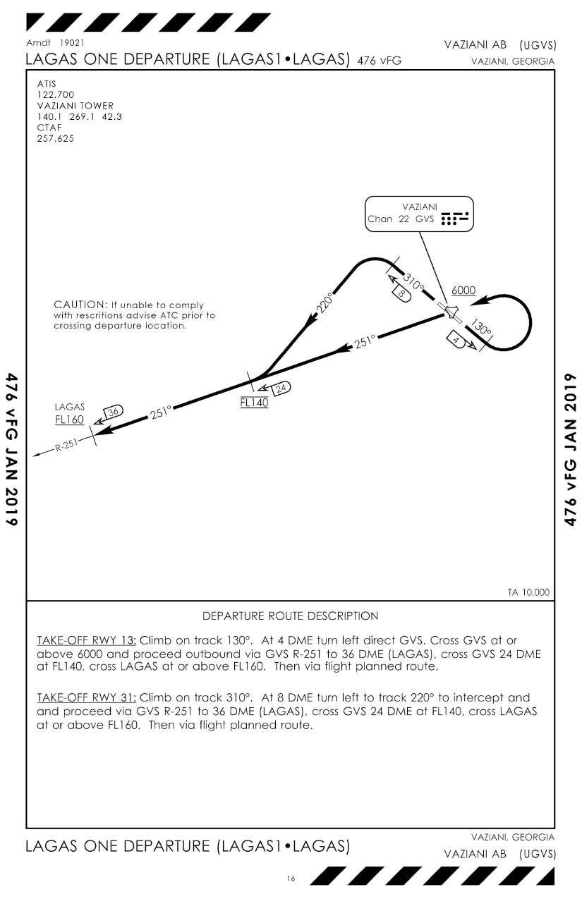
VAZIANI – UG27
SID LAGAS1 DEP– 1/2
ADC
Georgia
VOC
SID
IAC
Batumi
UG5X
Gudauta
UG5X
Kobuleti
UG5X
Kutaisi
Kopitnari
UG5X
Senaki
Kolkhi UG5X
Sukhumi
Babushara UG5X
Tbilisi
Lochini
UG5X
Tbilisi
Soganlug
UG5X
Vaziani
UG5X

Slide 18
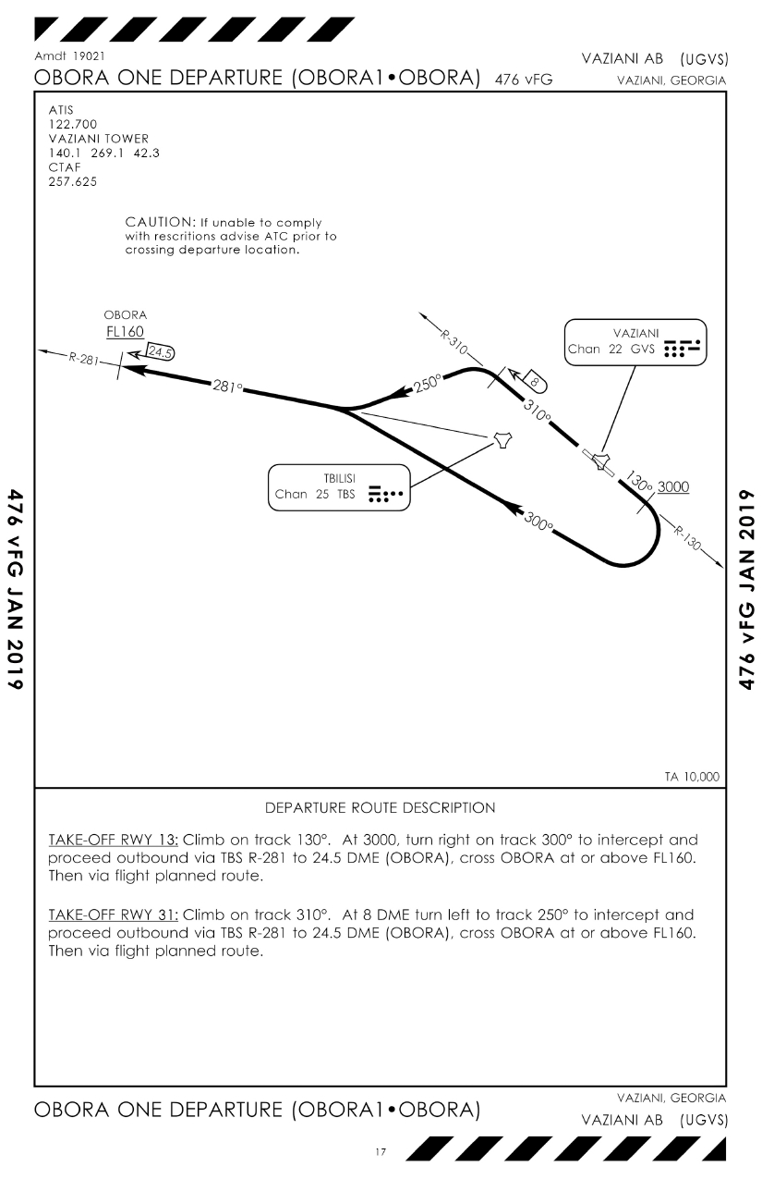
VAZIANI – UG27
SID OBORA1 DEP– 2/2
ADC
Georgia
VOC
SID
IAC
Batumi
UG5X
Gudauta
UG5X
Kobuleti
UG5X
Kutaisi
Kopitnari
UG5X
Senaki
Kolkhi UG5X
Sukhumi
Babushara UG5X
Tbilisi
Lochini
UG5X
Tbilisi
Soganlug
UG5X
Vaziani
UG5X

Slide 19
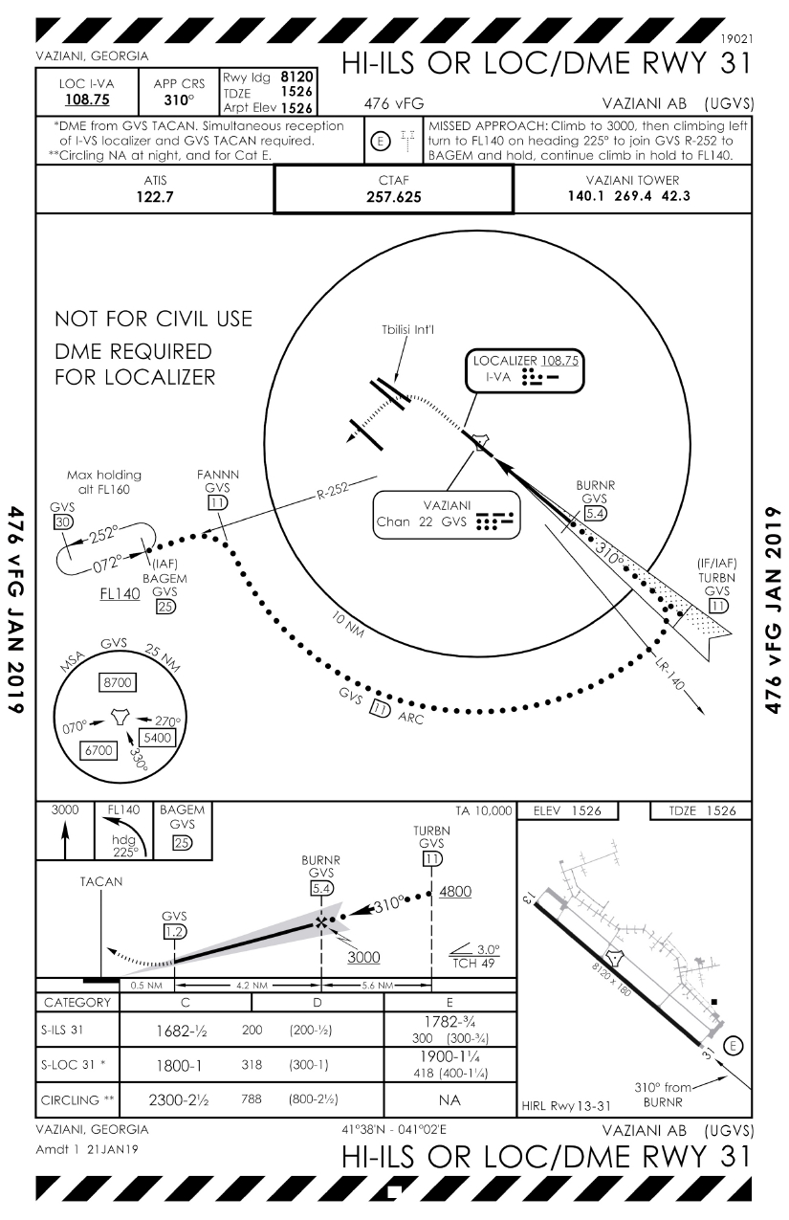
VAZIANI – UG27
HI-ILS OR LOC/DME RWY 31 – 1/3
ADC
Georgia
VOC
ATIS 122.7 | CTAF 256.625 | APP 127.2 248.25 | GCA 119.7 225.65 | VAZIANI TOWER 140.1 269.4
SID
IAC
Batumi
UG5X
Gudauta
UG5X
Kobuleti
UG5X
Kutaisi
Kopitnari
UG5X
Senaki
Kolkhi UG5X
Sukhumi
Babushara UG5X
Tbilisi
Lochini
UG5X
Tbilisi
Soganlug
UG5X
Vaziani
UG5X

Slide 20
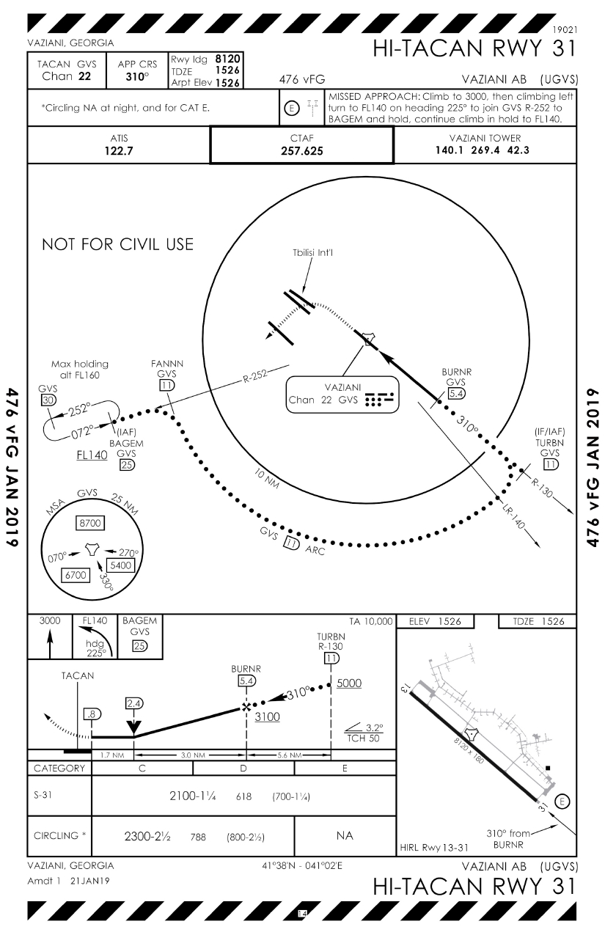
VAZIANI – UG27
HI-TACAN RWY 31 – 2/3
ADC
Georgia
VOC
ATIS 122.7 | CTAF 256.625 | APP 127.2 248.25 | GCA 119.7 225.65 | VAZIANI TOWER 140.1 269.4
SID
IAC
Batumi
UG5X
Gudauta
UG5X
Kobuleti
UG5X
Kutaisi
Kopitnari
UG5X
Senaki
Kolkhi UG5X
Sukhumi
Babushara UG5X
Tbilisi
Lochini
UG5X
Tbilisi
Soganlug
UG5X
Vaziani
UG5X

Slide 21
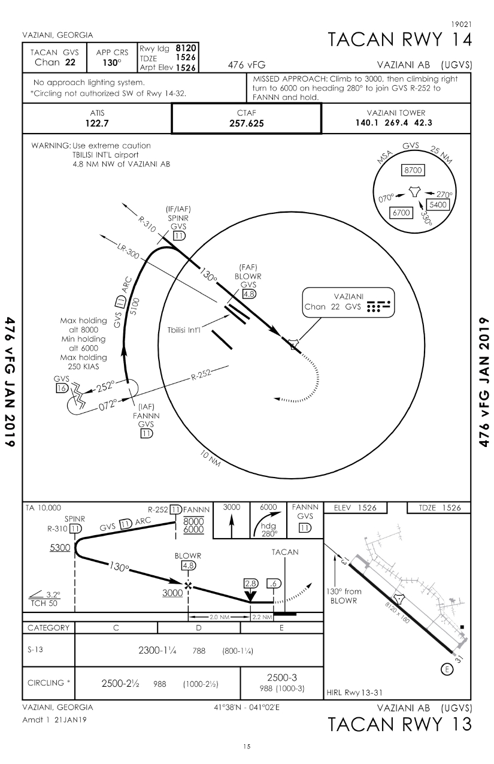
VAZIANI – UG27
TACAN RWY 14 – 3/3
ADC
Georgia
VOC
ATIS 122.7 | CTAF 256.625 | APP 127.2 248.25 | GCA 119.7 225.65 | VAZIANI TOWER 140.1 269.4
SID
IAC
Batumi
UG5X
Gudauta
UG5X
Kobuleti
UG5X
Kutaisi
Kopitnari
UG5X
Senaki
Kolkhi UG5X
Sukhumi
Babushara UG5X
Tbilisi
Lochini
UG5X
Tbilisi
Soganlug
UG5X
Vaziani
UG5X

Slide 22
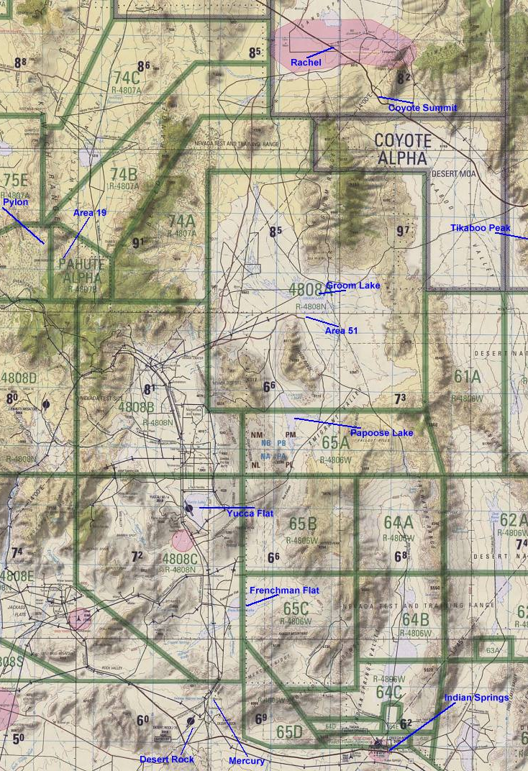
Nevada NTTR
ADC
VAD
SID
STAR
IAC
Nellis AFB
KLSV
Creech
KINS
Kobuleti
UG5X
Kutaisi
Kopitnari
UG5X
Senaki
Kolkhi UG5X
Sukhumi
Babushara UG5X
Tbilisi
Lochini
UG5X
Tbilisi
Soganlug
UG5X
Vaziani
UG5X

Slide 23
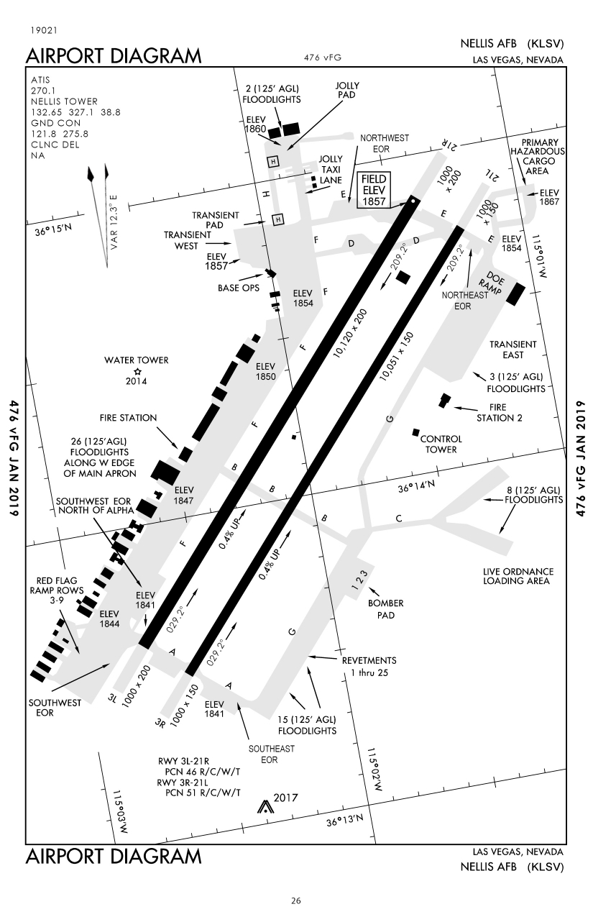
NELLIS AFB - KLSV
Aerodrome Chart – 1/1
ADC
Las Vegas, Nevada, USA
VOC
SID
IAC
Nellis AFB
KLSV
Creech
KINS
Kobuleti
UG5X
Kutaisi
Kopitnari
UG5X
Senaki
Kolkhi UG5X
Sukhumi
Babushara UG5X
Tbilisi
Lochini
UG5X
Tbilisi
Soganlug
UG5X
Vaziani
UG5X

Slide 24
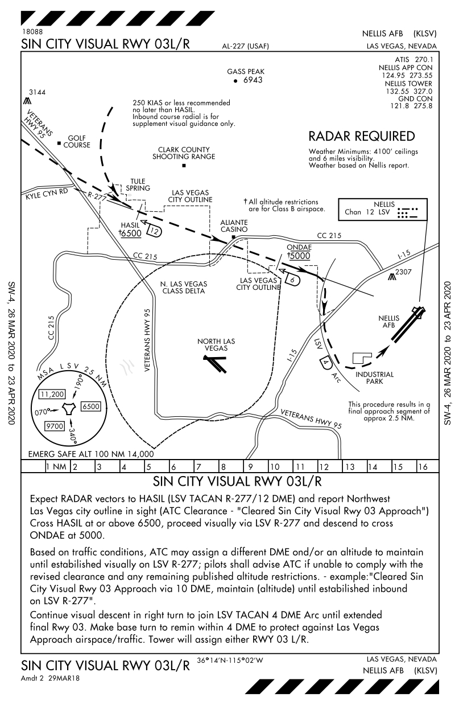
NELLIS AFB - KLSV
VISUAL APP RWY 03L/R
ADC
Las Vegas, Nevada, USA
VOC
SID
IAC
Nellis AFB
KLSV
Creech
KINS
Kobuleti
UG5X
Kutaisi
Kopitnari
UG5X
Senaki
Kolkhi UG5X
Sukhumi
Babushara UG5X
Tbilisi
Lochini
UG5X
Tbilisi
Soganlug
UG5X
Vaziani
UG5X

Slide 25
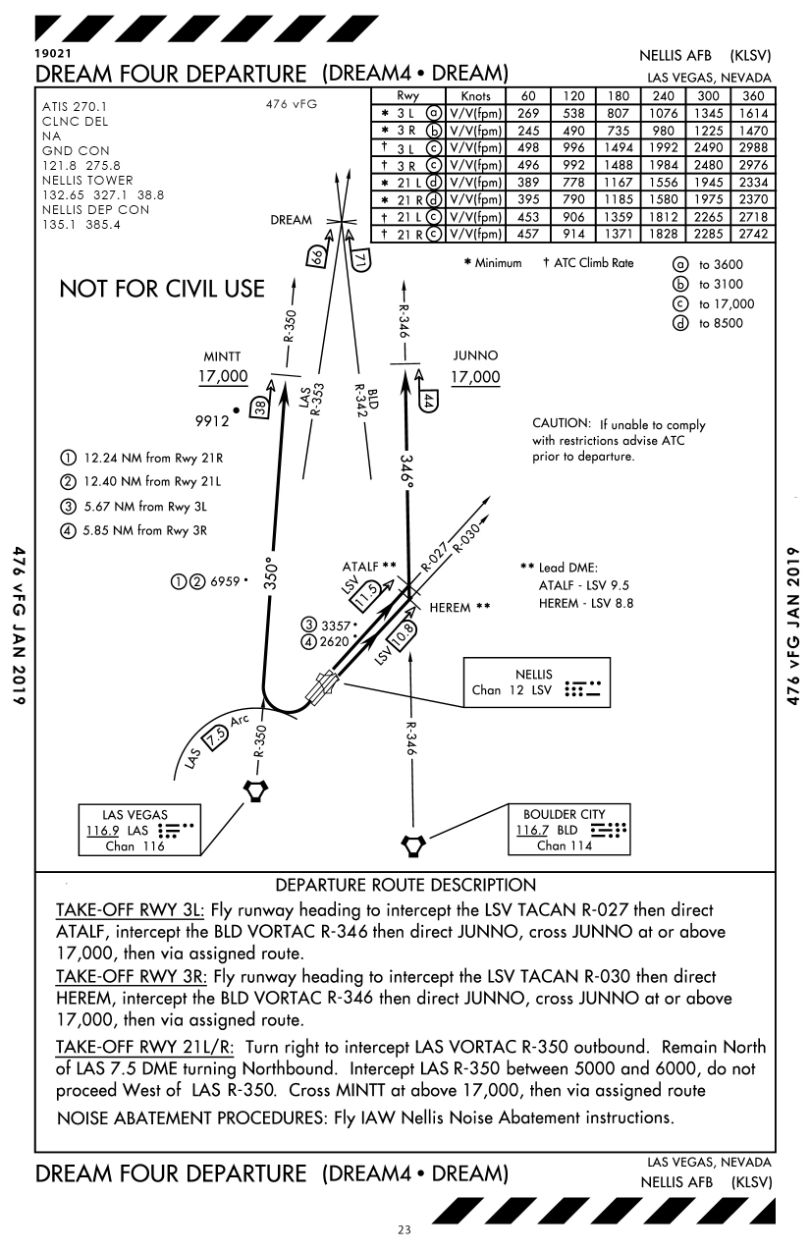
NELLIS AFB - KLSV
SID DREAM4 DEP – 1/3
ADC
Las Vegas, Nevada, USA
VOC
SID
IAC
Nellis AFB
KLSV
Creech
KINS
Kobuleti
UG5X
Kutaisi
Kopitnari
UG5X
Senaki
Kolkhi UG5X
Sukhumi
Babushara UG5X
Tbilisi
Lochini
UG5X
Tbilisi
Soganlug
UG5X
Vaziani
UG5X

Slide 26
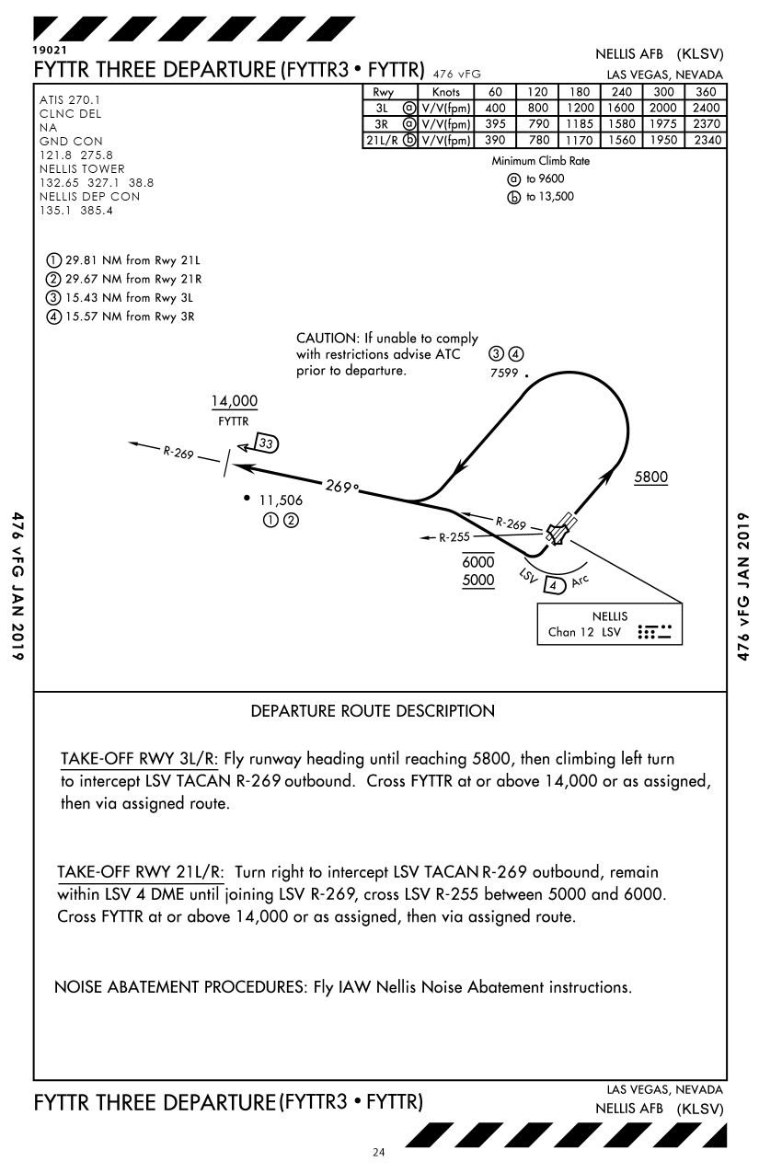
NELLIS AFB - KLSV
SID FYTTR3 DEP – 2/3
ADC
Las Vegas, Nevada, USA
VOC
SID
IAC
Nellis AFB
KLSV
Creech
KINS
Kobuleti
UG5X
Kutaisi
Kopitnari
UG5X
Senaki
Kolkhi UG5X
Sukhumi
Babushara UG5X
Tbilisi
Lochini
UG5X
Tbilisi
Soganlug
UG5X
Vaziani
UG5X

Slide 27
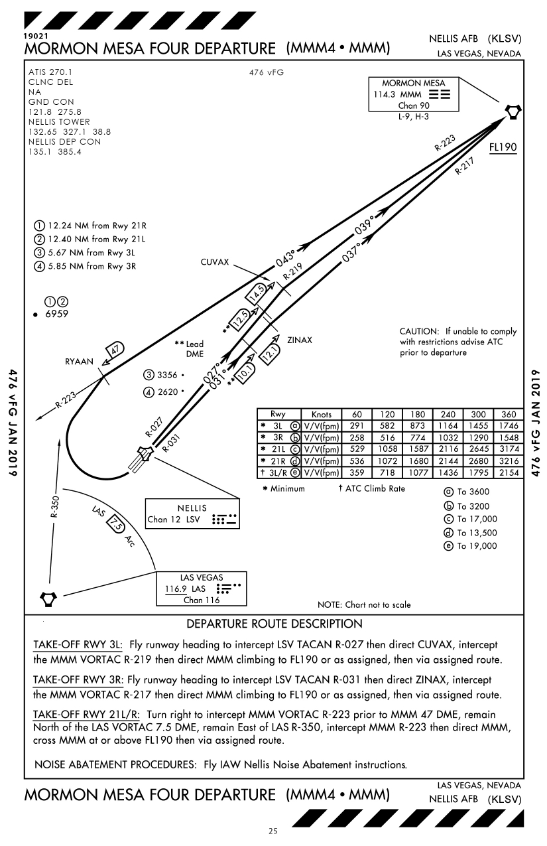
NELLIS AFB - KLSV
SID MORMON MESA4 DEP – 3/3
ADC
Las Vegas, Nevada, USA
VOC
SID
IAC
Nellis AFB
KLSV
Creech
KINS
Kobuleti
UG5X
Kutaisi
Kopitnari
UG5X
Senaki
Kolkhi UG5X
Sukhumi
Babushara UG5X
Tbilisi
Lochini
UG5X
Tbilisi
Soganlug
UG5X
Vaziani
UG5X

Slide 28
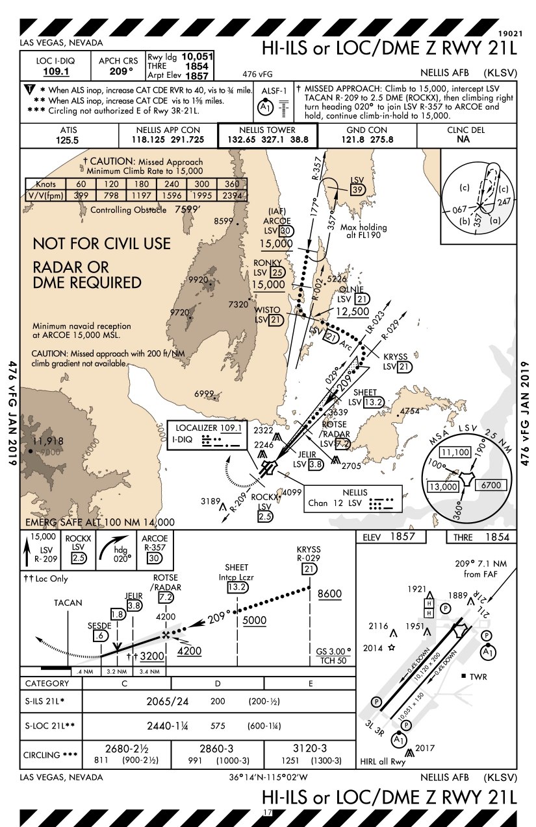
NELLIS AFB - KLSV
HI-ILS or LOC/DME Z RWY 21L
ADC
Las Vegas, Nevada, USA
VOC
SID
IAC
Nellis AFB
KLSV
Creech
KINS
Kobuleti
UG5X
Kutaisi
Kopitnari
UG5X
Senaki
Kolkhi UG5X
Sukhumi
Babushara UG5X
Tbilisi
Lochini
UG5X
Tbilisi
Soganlug
UG5X
Vaziani
UG5X

Slide 29
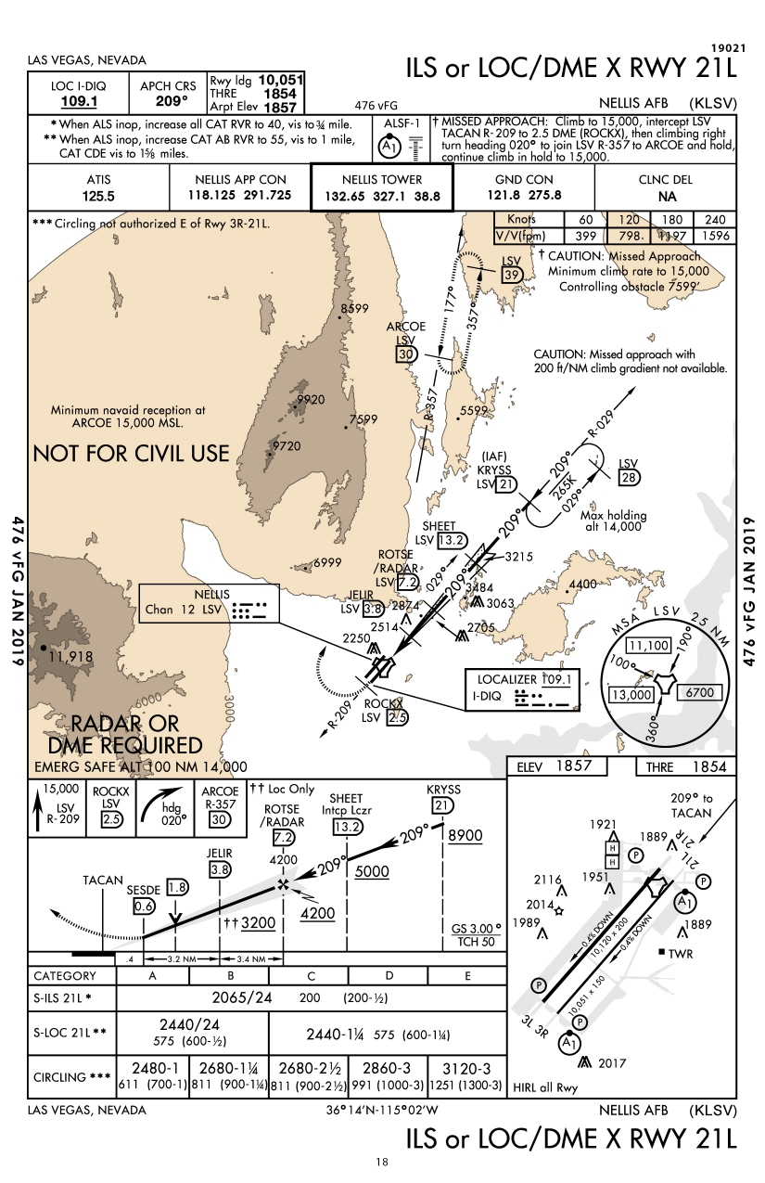
NELLIS AFB - KLSV
ILS or LOC/DME X RWY 21L
ADC
Las Vegas, Nevada, USA
VOC
SID
IAC
Nellis AFB
KLSV
Creech
KINS
Kobuleti
UG5X
Kutaisi
Kopitnari
UG5X
Senaki
Kolkhi UG5X
Sukhumi
Babushara UG5X
Tbilisi
Lochini
UG5X
Tbilisi
Soganlug
UG5X
Vaziani
UG5X

Slide 30
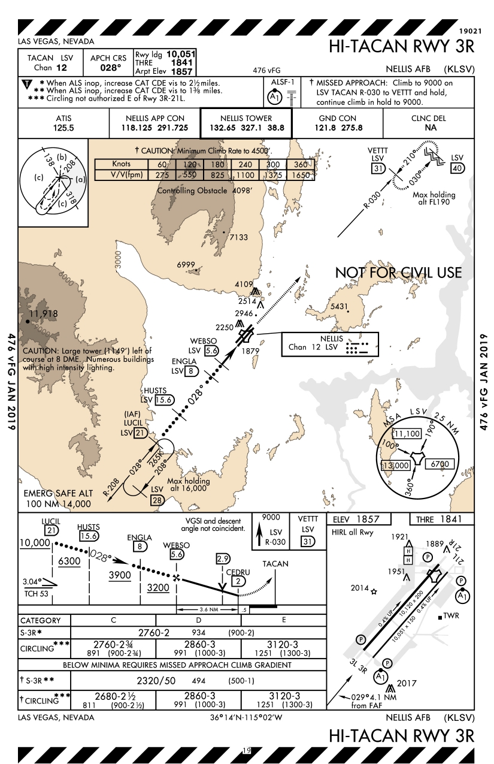
NELLIS AFB - KLSV
HI-TACAN RWY 3R
ADC
Las Vegas, Nevada, USA
VOC
SID
IAC
Nellis AFB
KLSV
Creech
KINS
Kobuleti
UG5X
Kutaisi
Kopitnari
UG5X
Senaki
Kolkhi UG5X
Sukhumi
Babushara UG5X
Tbilisi
Lochini
UG5X
Tbilisi
Soganlug
UG5X
Vaziani
UG5X

Slide 31
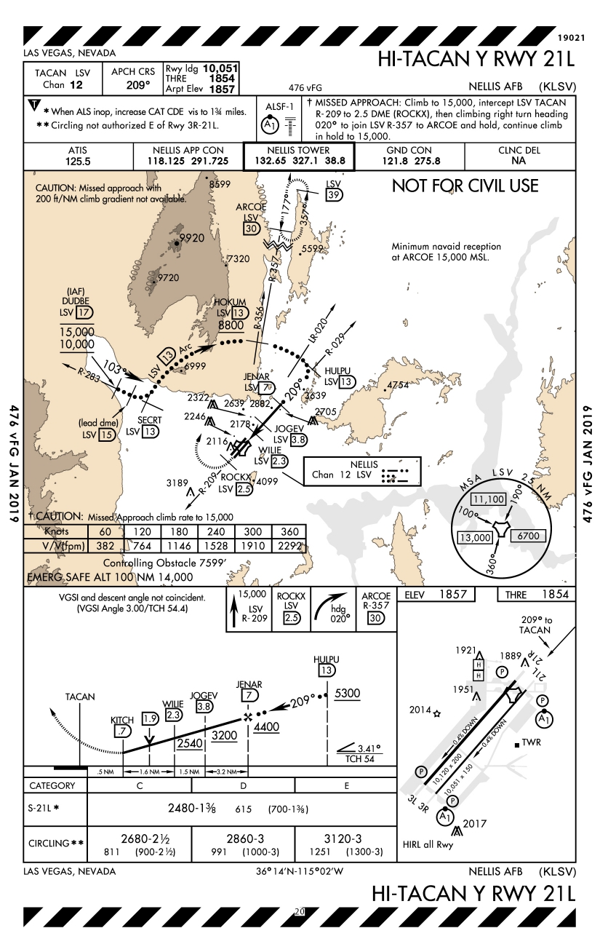
NELLIS AFB - KLSV
HI-TACAN Y RWY 21L
ADC
Las Vegas, Nevada, USA
VOC
SID
IAC
Nellis AFB
KLSV
Creech
KINS
Kobuleti
UG5X
Kutaisi
Kopitnari
UG5X
Senaki
Kolkhi UG5X
Sukhumi
Babushara UG5X
Tbilisi
Lochini
UG5X
Tbilisi
Soganlug
UG5X
Vaziani
UG5X

Slide 32
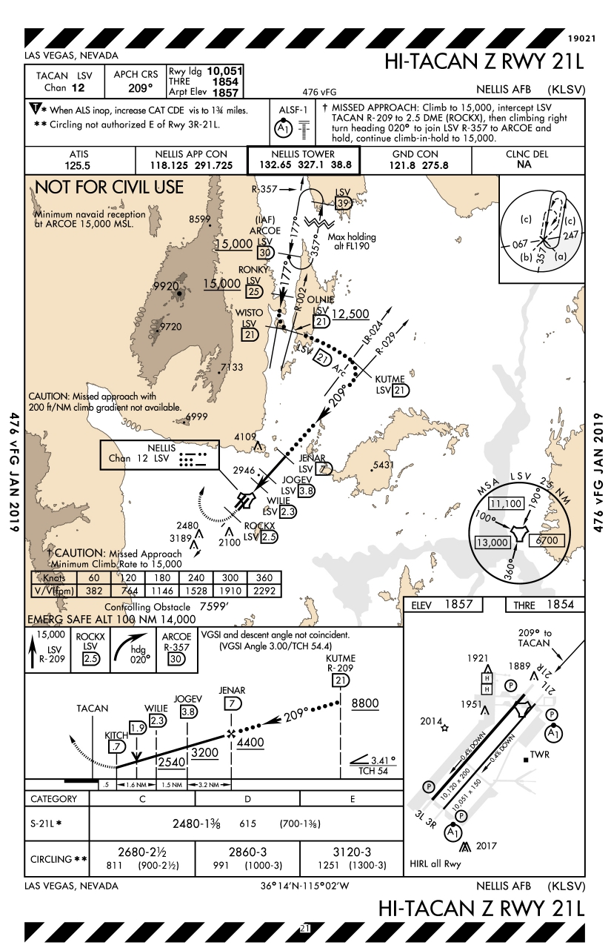
NELLIS AFB - KLSV
HI-TACAN Z RWY 21L
ADC
Las Vegas, Nevada, USA
VOC
SID
IAC
Nellis AFB
KLSV
Creech
KINS
Kobuleti
UG5X
Kutaisi
Kopitnari
UG5X
Senaki
Kolkhi UG5X
Sukhumi
Babushara UG5X
Tbilisi
Lochini
UG5X
Tbilisi
Soganlug
UG5X
Vaziani
UG5X

Slide 33
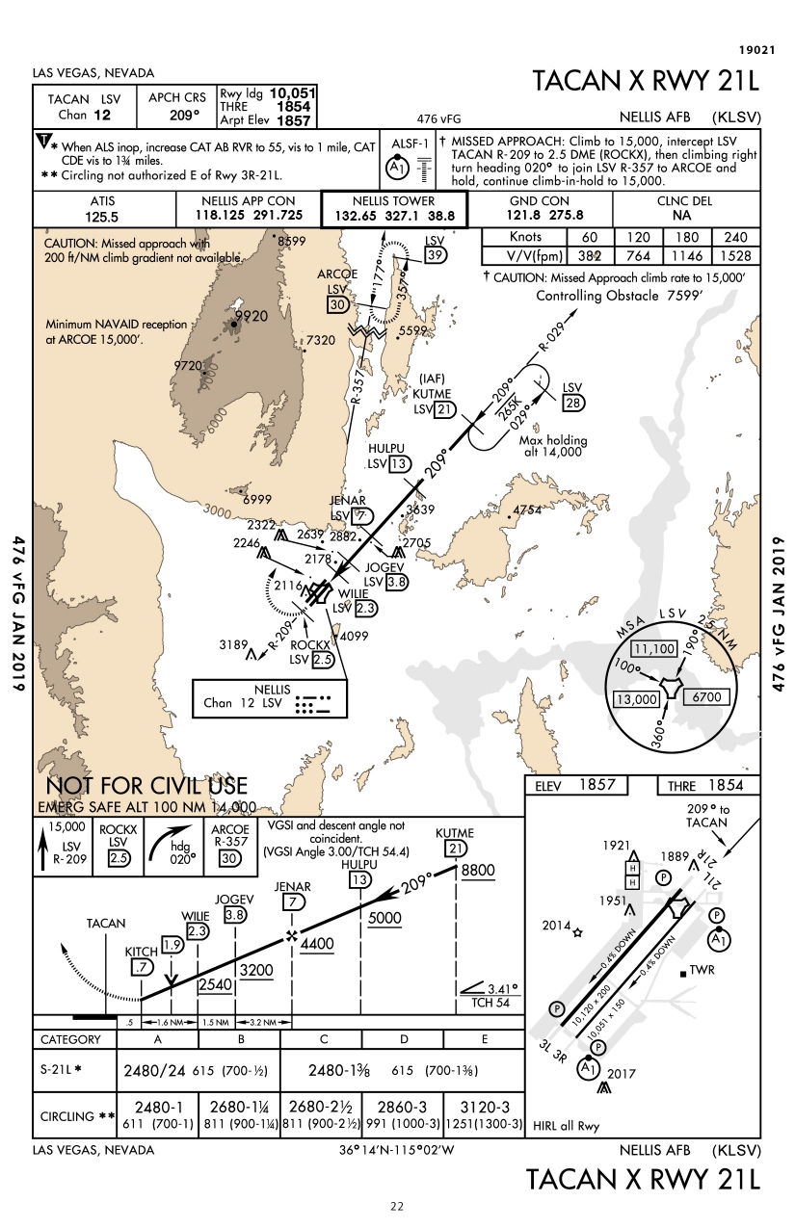
NELLIS AFB - KLSV
TACAN X RWY 21L
ADC
Las Vegas, Nevada, USA
VOC
SID
IAC
Nellis AFB
KLSV
Creech
KINS
Kobuleti
UG5X
Kutaisi
Kopitnari
UG5X
Senaki
Kolkhi UG5X
Sukhumi
Babushara UG5X
Tbilisi
Lochini
UG5X
Tbilisi
Soganlug
UG5X
Vaziani
UG5X

Slide 34
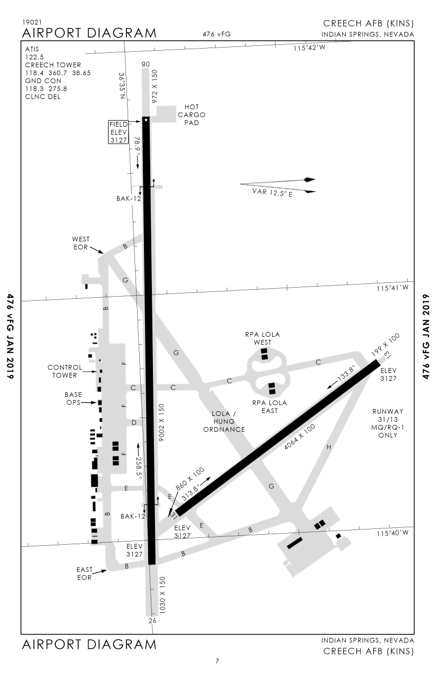
Chreech AFB - KINS
Aerodrome Chart – 1/1
ADC
Indian Springs, Nevada, USA
IAC
Nellis AFB
KLSV
Creech
KINS
Kobuleti
UG5X
Kutaisi
Kopitnari
UG5X
Senaki
Kolkhi UG5X
Sukhumi
Babushara UG5X
Tbilisi
Lochini
UG5X
Tbilisi
Soganlug
UG5X
Vaziani
UG5X

Slide 35
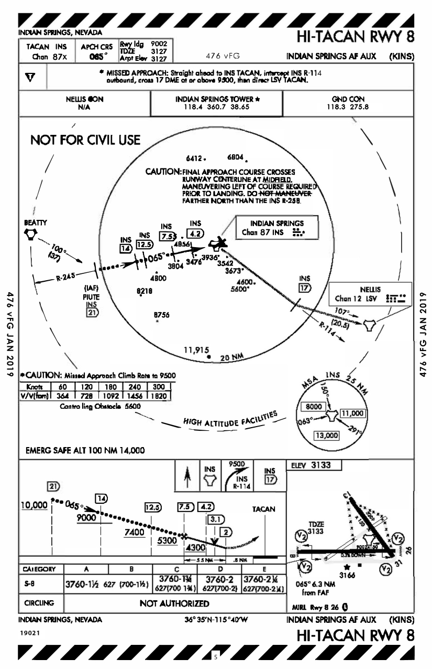
Chreech AFB - KINS
HI-TACAN RWY 8 – 1/2
ADC
Indian Springs, Nevada, USA
IAC
Nellis AFB
KLSV
Creech
KINS
Kobuleti
UG5X
Kutaisi
Kopitnari
UG5X
Senaki
Kolkhi UG5X
Sukhumi
Babushara UG5X
Tbilisi
Lochini
UG5X
Tbilisi
Soganlug
UG5X
Vaziani
UG5X

Slide 36
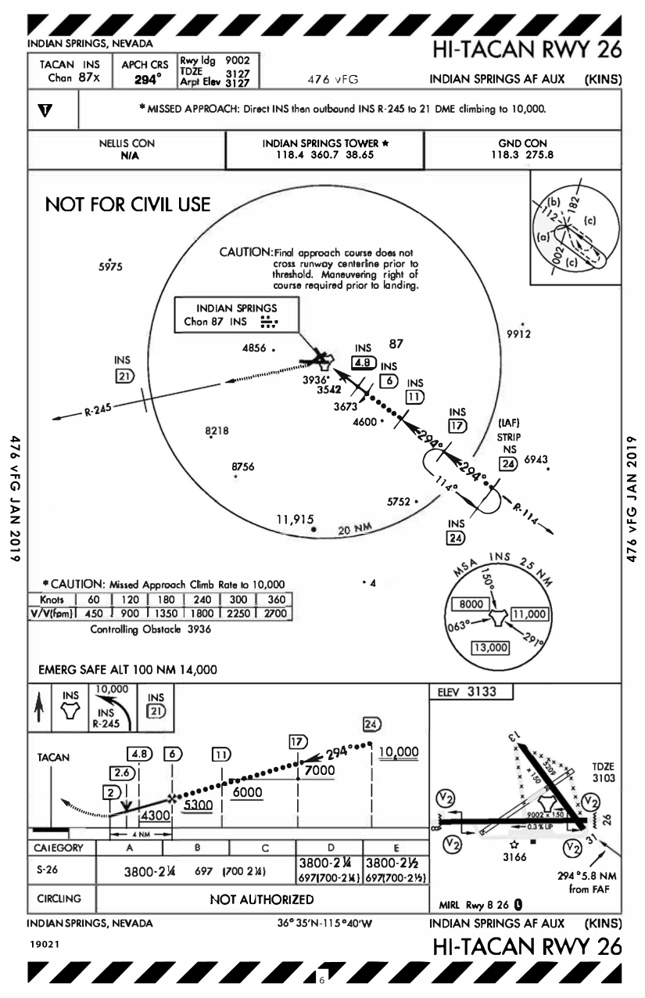
Chreech AFB - KINS
HI-TACAN RWY 26 – 2/2
ADC
Indian Springs, Nevada, USA
IAC
Nellis AFB
KLSV
Creech
KINS
Kobuleti
UG5X
Kutaisi
Kopitnari
UG5X
Senaki
Kolkhi UG5X
Sukhumi
Babushara UG5X
Tbilisi
Lochini
UG5X
Tbilisi
Soganlug
UG5X
Vaziani
UG5X

